Slide 1
Real-Time Embedded Traffic Sign Classification
Submitted To
Samsuddin Ahmed
Assistant professor, CSE, BUBT

Slide 2
problem statement
In the world of Artificial Intelligence and advancement in technologies, many researchers and big companies like Tesla, Uber, Google, Mercedes-Benz, Toyota, Ford, Audi, etc. are working on autonomous vehicles and self-driving cars. So, for achieving accuracy in this technology, the vehicles should be able to interpret traffic signs and make decisions
accordingly.

Slide 3
dataset
The training data for this project comes from the German Traffic Sign Dataset.

Slide 4
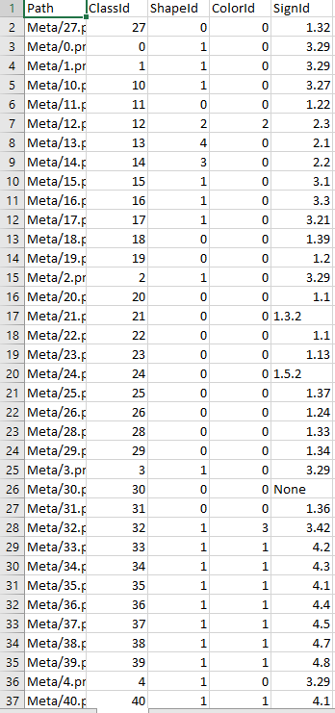
Validation Samples:

Slide 5
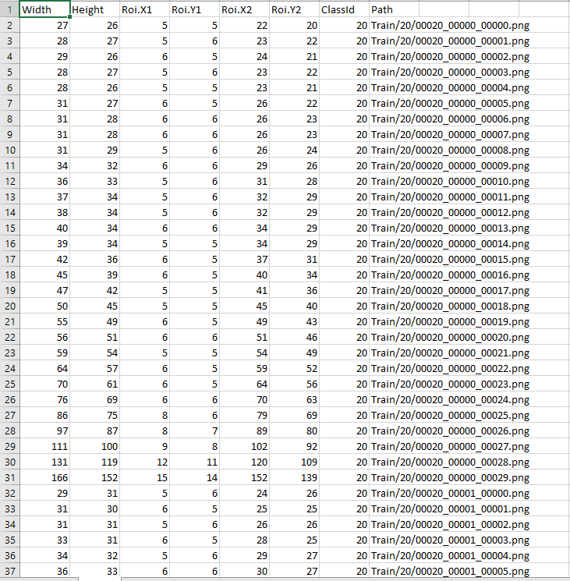
Training Samples:

Slide 6
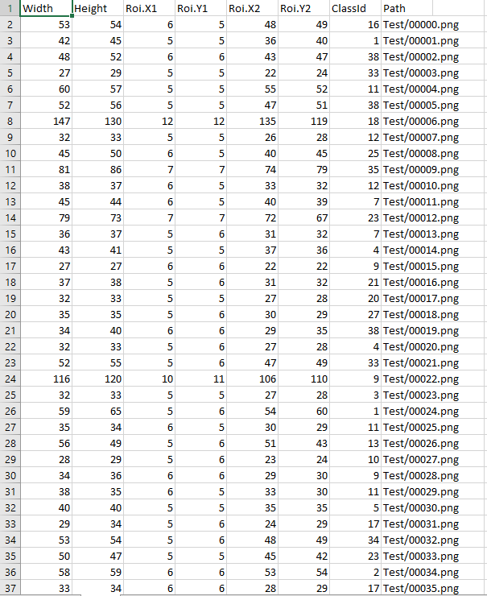
Testing Samples:

Slide 7
The notebook will automatically fetch this data and it is not directly included in the repository. The images are 32x32 and depict one of 43 different classes of signs. The images come split into 34,799 training images and 12,630 test images. There is some class imbalance. The training/validation split is stratified to help with this.

Slide 8
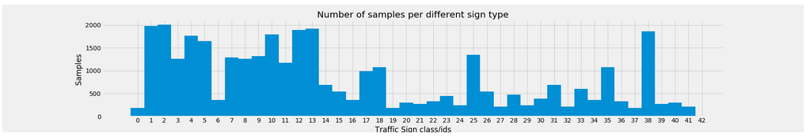
Fig - Distribution of sign classes.

Slide 9
There are a number of challenges in the GTSRB dataset, the first being that images are low resolution, and worse, have poor contrast .These images are pixelated, and in some cases, it’s extremely challenging, if not impossible, for the human eye and brain to recognize the sign.

Slide 10
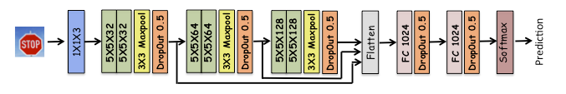
Model Architecture
Figure below presents the model architecture we will use. This architecture was converged upon after trying several different architectures.

Slide 11
A Convolutional neural network (CNN) is a neural network that has one or more convolutional layers and are used mainly for image processing, classification, segmentation and also for other auto correlated data. A convolution is essentially sliding a filter over the input.
That’s why we use CNN classification.

Slide 12
Platform
Hardware:
For the tests we use a CPU Intel Core2 Duo T6500 at 2.10GHz with 2GB DDR3 RAM (used for 16x16 data).
A Detector Classifier B Classifier A Classifier CPU Intel Core(TM)2 DuoE8400 at 3.0GHz with 4GB DDR3 RAM (32x32 data).
It is no secret that this type of hardware does not guarantee high processing speed. We must stress the fact that the purpose of this thesis is in fact not to reach top classification performances and neither to run the training for a very high number of epochs. We focus on comparing performances of different study cases with the same network model and training parameters. We are satisfied with the results once the training is converged. Then we compare the study cases and draw conclusions.

Slide 13
Software:
Google Colaboratory.
Microsoft Excel

Slide 14
Experimental setup
The GTSRB is composed of highly unbalanced data. Some of the classes only have 200 images, which is quite a limitation for deep learning. We use the same subset of images for validation and testing (there is no update of hyper parameters during the training to justify validation-only data). We still keep track of both training and validation accuracy to avoid over fitting. The data is sorted out randomly as shown in roughly one third of images are used for training and two thirds for testing.

Slide 15
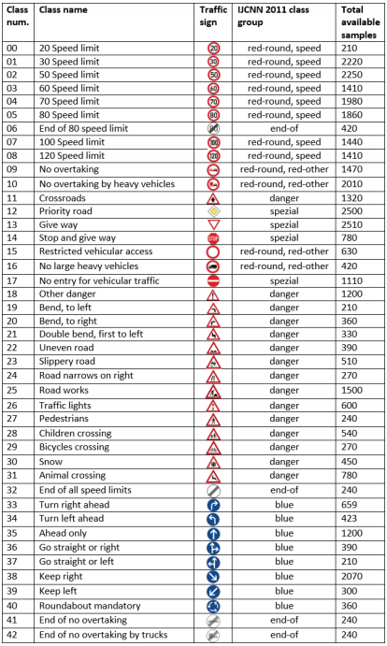

Slide 16
results
Training And Testing Performance:
After building the model architecture, we then train the model using model.fit(). I tried with batch size 32 and 64. Our model performed better with 64 batch size. And after 30 epochs the accuracy was stable. Our model got a 98.40% accuracy on the training dataset. With matplotlib, we plot the graph for accuracy and the loss. Using the raw 32x32 rescaled images reaches 98.40% accuracy on the test data in about 30 iterations. Below in the table the classification rate and the false alarm rate obtained by averaging class rates. The confusion matrix is shown as well. The empty cells in the matrix are zeros.

Slide 17
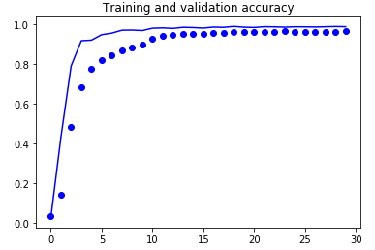
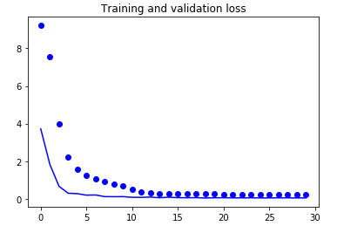
Training and Validation (Accuracy and Loss)

Slide 18
Table:
N. of signs | Avg. classification rate [%] | Avg. false alarm rate [%]
11763 | 98.40 | 0.63

Slide 19
Thank You

